Slide 1
Ordering fractions in different ways
Comparing and ordering fractions and decimals (positive and negative)

Slide 2
how to use Oak lessons

Slide 3
I can compare and order fractions using a range of techniques.

Slide 4

A denominator is the expression in a fraction that is written below the fraction line. It is the divisor.
A numerator is the expression in a fraction that is written above the fraction line. It is the dividend.
numerator
denominator
A proper fraction is a fraction where the numerator is less than the denominator.

Slide 5

Ordering fractions in different ways
Comparing fractions using a common numerator
Ordering by comparing to one

Slide 6

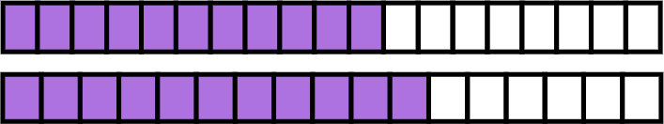
Comparing fractions using a common numerator
Which is greater?
?
<
Is it always necessary to find a common denominator?

Slide 7



Comparing fractions using a common numerator
is
greater
than
.
The ‘parts’ are larger in
The ‘parts’ are larger in

Slide 8



Comparing fractions using a common numerator
Which is greater?
<
?
What could we do here?
We can simplify
Now we can create an equivalent fraction with a denominator of 400 so that we can compare them.
We can now see which is greater.

Slide 9

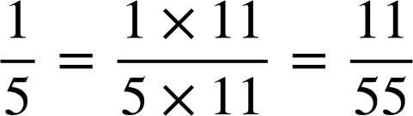
Comparing fractions using a common numerator
Which is greater?
?
>
Would it be sensible to try and find the LCM of 5 and 37 238?
In this situation it would be much more efficient to
convert
into an equivalent fraction with a numerator of 11.

Slide 10
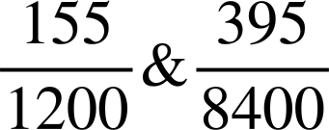
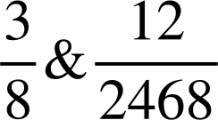
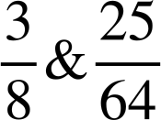
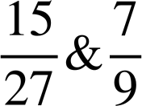
Comparing fractions using a common numerator
In which of the following would it be easier to compare the numerators?
Which is greater?
1200 is a factor of 8400
Which is greater?
3 is a factor of 12
Which is greater?
8 is a factor of 64
Which is greater?
9 is a factor of 27

Slide 11

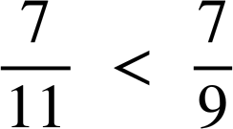
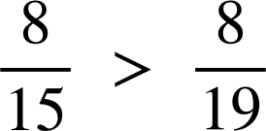
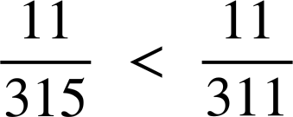
Comparing fractions using a common numerator
Insert either < or > to make the statement true.
a)
c)
b)
d)
e) Place the words ‘larger’ and ‘smaller’ in the sentence:
The the denominator the the ‘parts’.

Slide 12
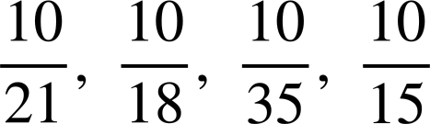
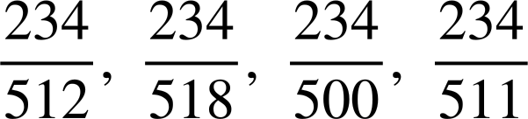
Comparing fractions using a common numerator
2) Write the following in order from smallest to largest.
a)
b)

Slide 13



Comparing fractions using a common numerator
3a) Place the words ‘larger’ and ‘smaller’ in the sentence:
is
____
than
but
____
than
.
Jacob says
‘
is
exactly
halfway
between
and
.’
Is he correct?
Find
another
fraction
between
and
.
Find
a
fraction
that
is
closer
to
.
Find the fraction that is exactly halfway
between
and
.

Slide 14
Comparing fractions using a common numerator
Insert either < or > to make the statement true.
a)
c)
b)
d)
e) Place the words ‘larger’ and ‘smaller’ in the sentence:
The larger the denominator the smaller the ‘parts’.

Slide 15
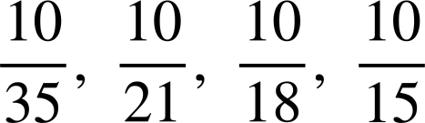
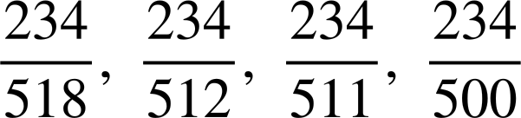
Comparing fractions using a common numerator
2) Write the following in order from smallest to largest.
a)
b)

Slide 16
Comparing fractions using a common numerator
3a) Place the words ‘larger’ and ‘smaller’ in the sentence:
is
larger
than
but
smaller
than
.
Jacob says
‘
is
exactly
halfway
between
and
.’
Is he correct?
Jacob is not correct, it is closer to

Slide 17
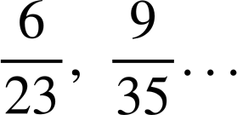
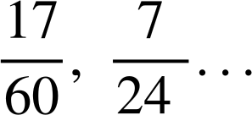

Comparing fractions using a common numerator
Find
another
fraction
between
and
.
e.g.
Find
a
fraction
that
is
closer
to
.
e.g.
Find the fraction that is exactly halfway
between
and
.

Slide 18
Ordering fractions in different ways
Comparing fractions using a common numerator
Ordering by comparing to one

Slide 19
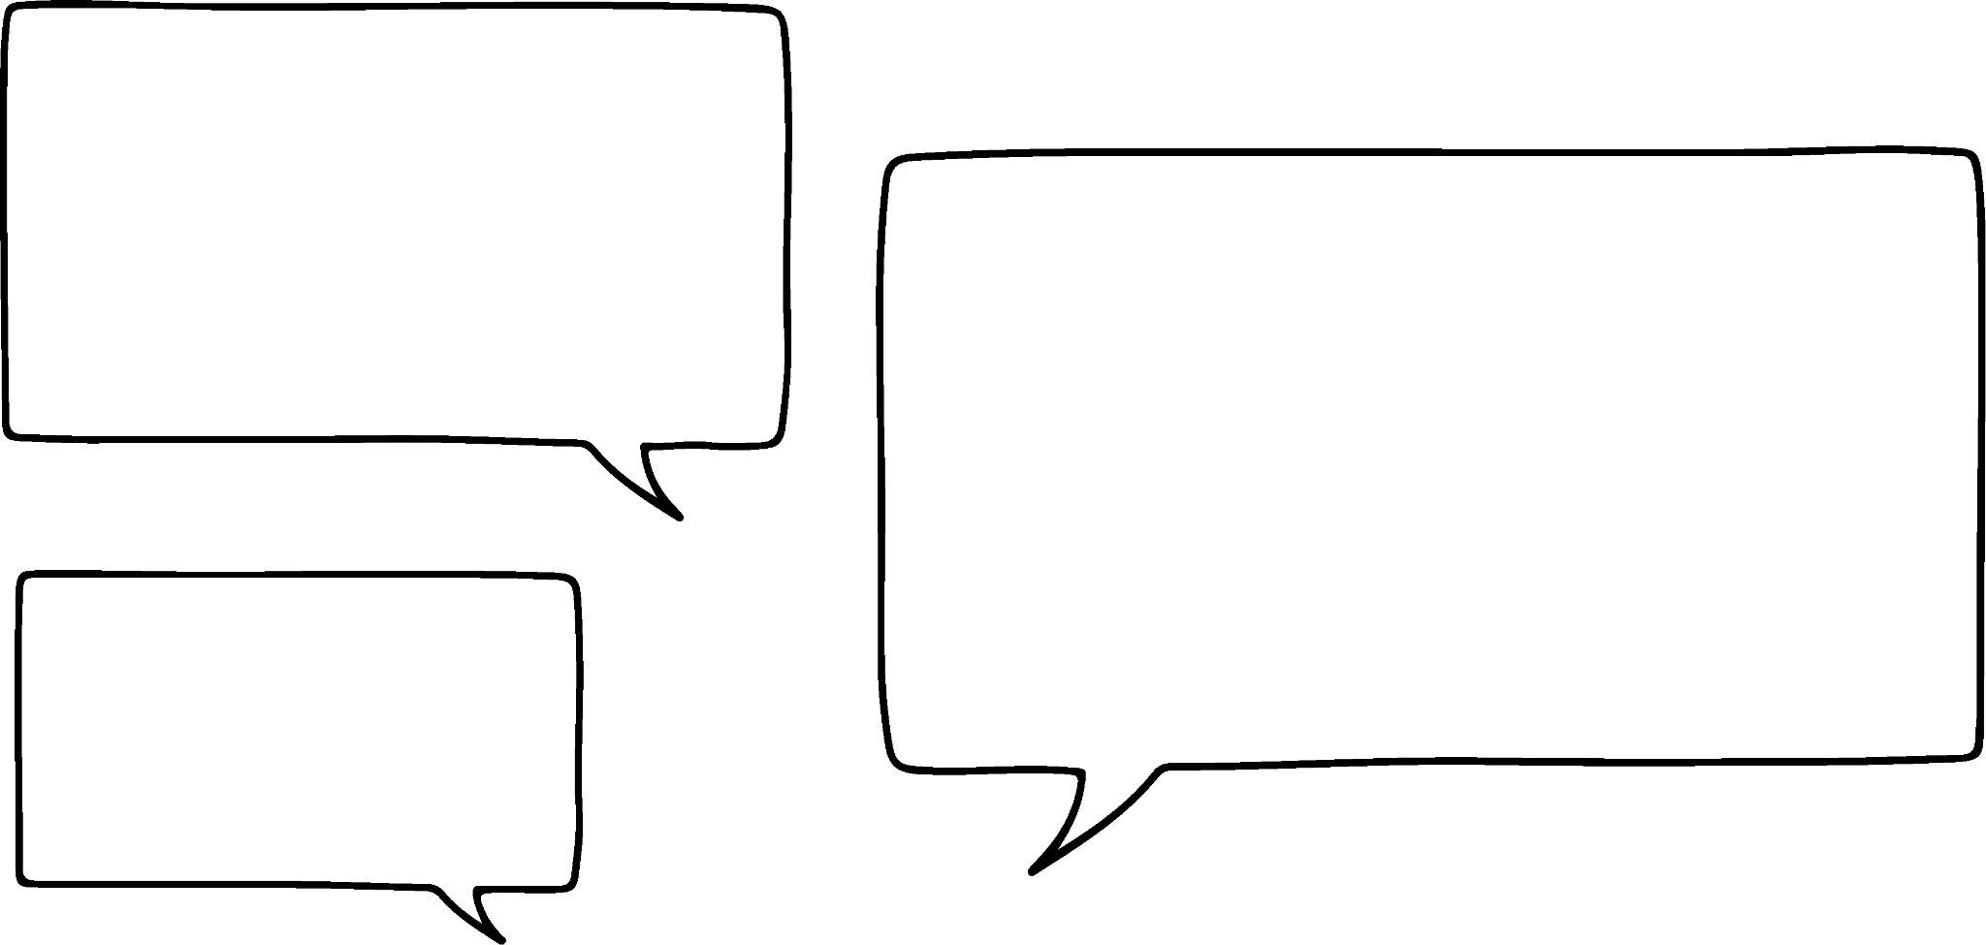
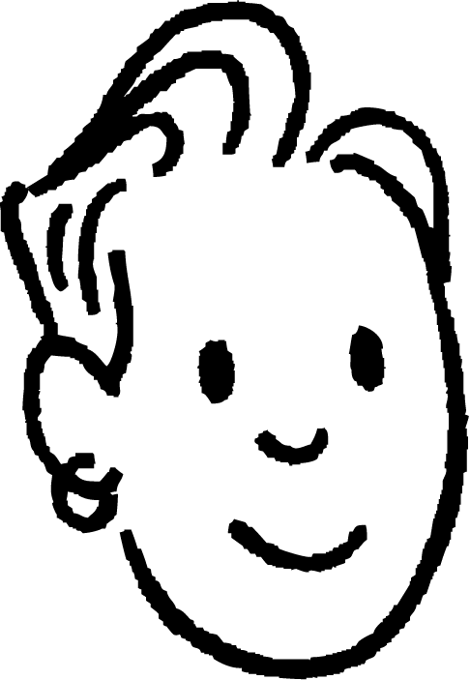
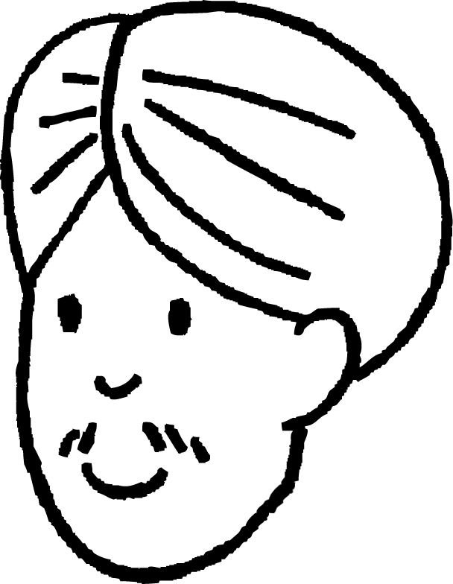
Ordering by comparing to one
Sam and Andeep took part in a maths competition.
They both entered different rounds.
That means we both did as well as each other as we only got 1 wrong.
I think you did better as you had more questions.
I scored
7 out of 8.
I scored
5 out of 6.
Sam
Andeep
Do you agree with Sam or Andeep?

Slide 20


Ordering by comparing to one
So, if I was right
We can write each of our fractions with a common denominator to see which is larger.
We could, but your fraction is larger as it is closer to one.
I could write my
Yes, and we know that they are not equal.
that
would
mean
Mine
would
be
.
score as a fraction.
and
are equal.
It
would
be
.
Sam
Andeep

Slide 21
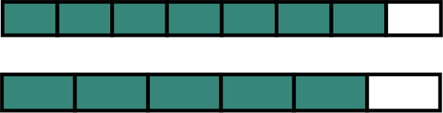
Ordering by comparing to one
We will look at the fraction bars to see if Andeep is right.
Sam
Andeep
We can see that both fractions are less than one but Andeep’s fractions is further away from one.
That means Sam actually did better in the competition.

Slide 22


Ordering by comparing to one
Is it possible to to decide which proper fraction is the greater fraction by comparing it to one without a fraction bar?
Which is greater?
<
?
These are both 3 ‘parts’ away from 1.
Which fraction will have the larger parts?
will have the larger parts as the unit is split into fewer parts.
This means that although they are both 3 ‘parts’ away from one,
is
closer
to
1
as the
‘parts’
in
are smaller.

Slide 23
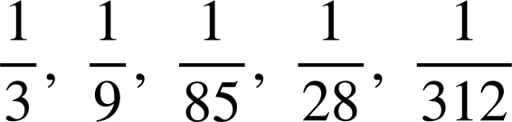
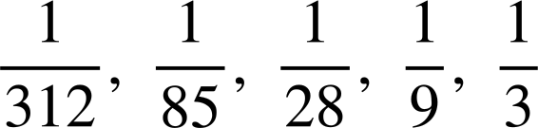
Ordering by comparing to one
List the following in order from which has the smallest ‘parts’ to largest ‘parts’.

Slide 24
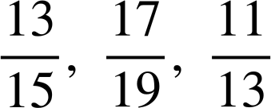
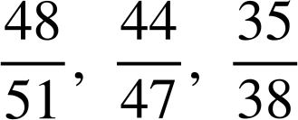
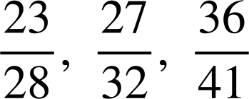
Ordering by comparing to one
Which of the following is in the correct order? (smallest to largest)

Slide 25
Ordering by comparing to one
We now have 4 different methods for comparing fractions:
common denominator
comparing numerators
simplifying and comparing
comparing proper fractions to 1

Slide 26
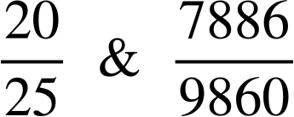
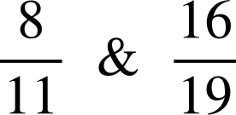
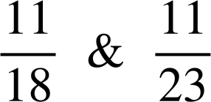
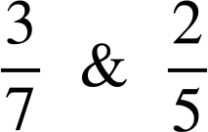
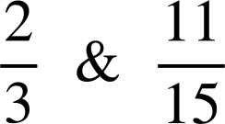
Ordering by comparing to one
Which method?
simplify
and
compare
compare
to one
compare numerators
compare denominator
common denominator

Slide 27


Ordering by comparing to one
Which is greater?
<
?
Both are 2 ‘parts’ away from 1.
is 2 smaller ‘parts’.

Slide 28
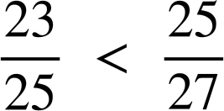
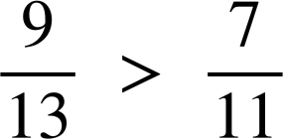
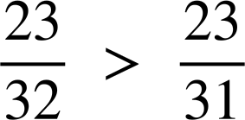
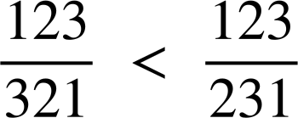
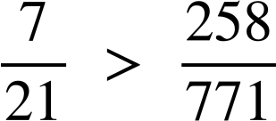
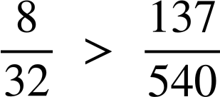
Ordering by comparing to one
Choose the most appropriate method to decide which of the following statements are true.
a)
d)
b)
e)
c)
f)

Slide 29

Ordering by comparing to one
2) Explain why Aisha is wrong.
is larger than
Aisha

Slide 30
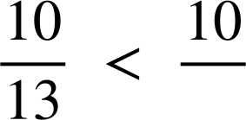
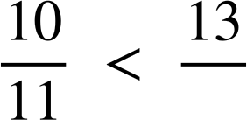
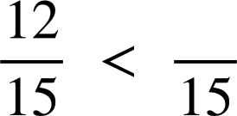
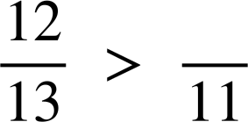
Ordering by comparing to one
3) Use these numbers to complete the following proper fractions. 10, 11, 12, 13, 14 and 15.
The fraction closest to one
The fraction closest to zero
e)
f)

Slide 31
Ordering by comparing to one
Choose the most appropriate method to decide which of the following statements are true.
a)
d)
True
True
b)
e)
False
True
c)
f)
False
False

Slide 32
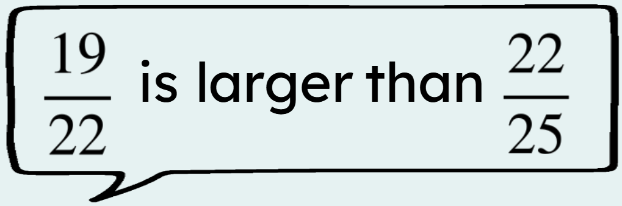
Ordering by comparing to one
2) Explain why Aisha is wrong.
Aisha
E.g. Although they are both 3 ‘parts’ away from 1, the ‘parts’ are larger in so it further from 1.

Slide 33


Ordering by comparing to one
3) Use these numbers to complete the following proper fractions. 10, 11, 12, 13, 14 and 15.
The fraction closest to one
The fraction closest to zero
e)
11 or 12
14 or 15
d)
13 or 14
10
f)

Slide 34
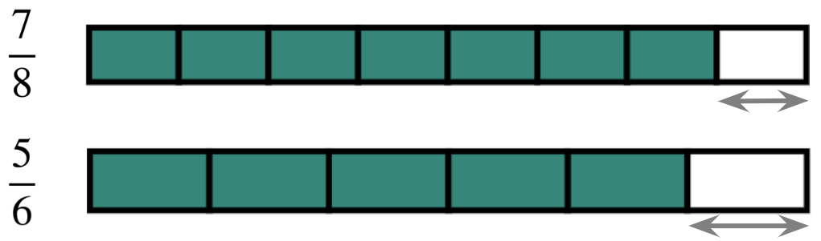
Ordering fractions in different ways
In fractions, the larger the denominator the smaller the ‘parts’.
Fractions can be compared using the numerator.
E.g.
Fractions can be compared by considering their distance from one. E.g. is larger as it is closer to 1.
>

Slide 35

© Oak National Academy 2023.
Produced in partnership with Mathematics in Education and Industry.
Licensed on the Open Government Licence v3.0, except where otherwise stated. See Oak terms and conditions.

